Slide 1
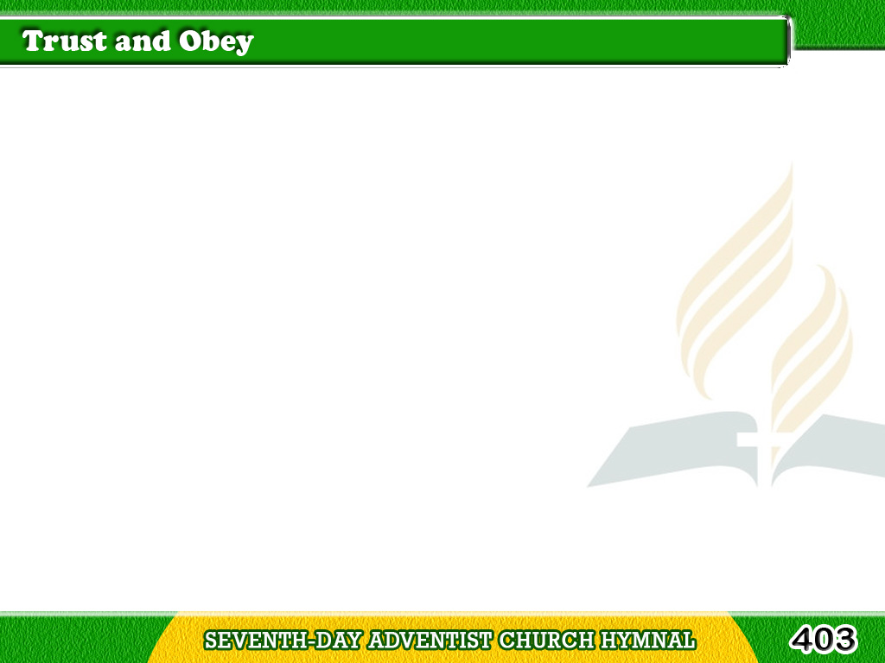
1/5
When we walk with the Lord
In the light of His word,
What a glory He sheds
on our way!
Tagalog
Version

Slide 2
1/5
While we do His good will,
He abides with us still,
And with all
who will trust and obey.
Tagalog
Version

Slide 3
1/5
Chorus
Trust and obey,
for there’s no other way
To be happy in Jesus,
but to trust and obey.
Tagalog
Version

Slide 4
2/5
Not a shadow can rise,
Not a cloud in the skies,
But His smile
quickly drives it away;
Tagalog
Version

Slide 5
2/5
Not a doubt nor a fear,
Not a sigh nor a tear,
Can abide while
we trust and obey.
Tagalog
Version

Slide 6
2/5
Chorus
Trust and obey,
for there’s no other way
To be happy in Jesus,
but to trust and obey.
Tagalog
Version

Slide 7
3/5
Not a burden we bear,
Not a sorrow we share,
But our toil He doth
richly repay;
Tagalog
Version

Slide 8
3/5
Not a grief nor a loss,
Not a frown nor a cross,
But is blest
if we trust and obey.
Tagalog
Version

Slide 9
3/5
Chorus
Trust and obey,
for there’s no other way
To be happy in Jesus,
but to trust and obey.
Tagalog
Version

Slide 10
4/5
But we never can prove
The delights of His love,
Until all on the altar we lay,
Tagalog
Version

Slide 11
4/5
For the favor He shows,
And the joy He bestows,
Are for them
who will trust and obey.
Tagalog
Version

Slide 12
4/5
Chorus
Trust and obey,
for there’s no other way
To be happy in Jesus,
but to trust and obey.
Tagalog
Version

Slide 13
5/5
Then in fellowship sweet
We will sit at His feet,
Or we’ll walk
by His side in the way;
Tagalog
Version

Slide 14
5/5
What He says we will do,
Where He sends we will go,
Never fear, only trust and obey.
Tagalog
Version

Slide 15
5/5
Chorus
Trust and obey,
for there’s no other way
To be happy in Jesus,
but to trust and obey.
Tagalog
Version

